Slide 1
Sentiment Analysis IMDb Movie Reviews Sentiment Classification

Slide 2
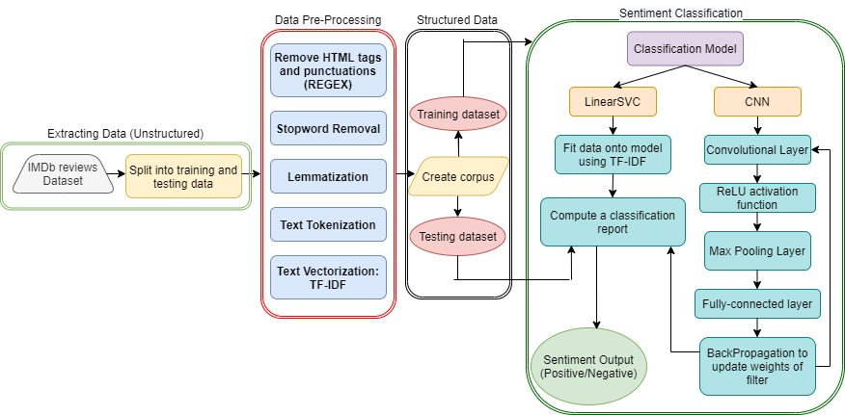
Project Overview
Figure 1: Block Diagram of IMDb movie reviews sentiment classification

Slide 3
Pre-Processing Data
Original review from dataset
Phil the Alien is one of those quirky films where the humour is based around the oddness of everything rather than actual punchlines.<br /><br />At first it was very odd and pretty funny but as the movie progressed I didn't find the jokes or oddness funny anymore.<br /><br />Its a low budget film (that’s never a problem in itself), there were some pretty interesting characters, but eventually I just lost interest.<br /><br />I imagine this film would appeal to a stoner who is currently partaking.<br /><br />For something similar but better try "Brother from another planet"
After removal of HTML tags and punctuation marks
phil the alien is one of those quirky films where the humour is based around the oddness of everything rather than actual punchlines at first it was very odd and pretty funny but as the movie progressed i didn t find the jokes or oddness funny anymore its a low budget film thats never a problem in itself there were some pretty interesting characters but eventually i just lost interest i imagine this film would appeal to a stoner who is currently partaking for something similar but better try brother from another planet

Slide 4


Pre-Processing Data
Removal of stopwords
he | are | be | from | or | the | were | for | have | but
NOT PREFERRED
Stemming
pretti | quirki | funni | everyth | someth | tri | eventu | partak | charact | anymor
USED IN THIS PROJECT
Lemmatization
pretty | quirky | funny | everything | something | try | eventually | partaking | character | anymore

Slide 5
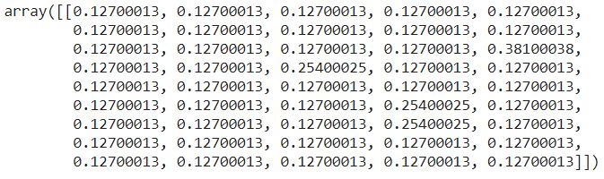
Pre-Processing Data
TFIDF Vectorization
Term Frequency, TF(i,j) = $\frac{Term i frequency in review j}{Total number of words in review}$
Inverse Document Frequency, IDF(i) = $\log_{2} \frac{Total number of reviews}{Reviews with term i}$
TFIDF score for term i in review j = TF(i,j) * IDF(i)

Slide 6
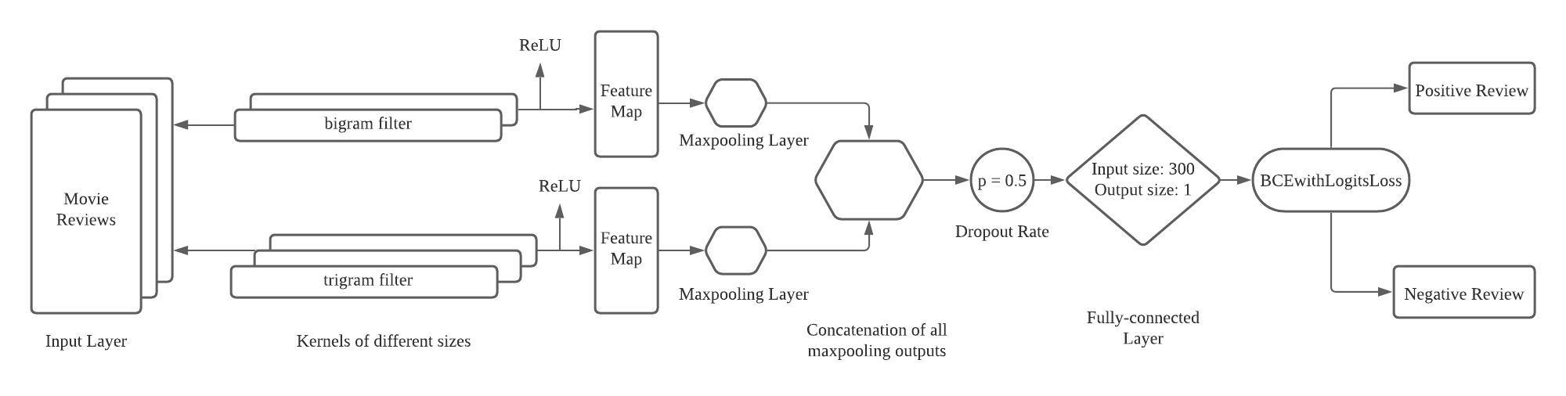
CNN model
Figure 2: Architecture of CNN of IMDb movie reviews sentiment classification

Slide 7
COMPARISON BETWEEN LINEARSVC AND CNN
Table 1: Comparison between LinearSVC and CNN in terms of accuracy and loss
Aspects/Classification Model | LinearSVC | CNN
Training Accuracy | 97.34% | 96.52%
Test Accuracy | 93.23% | 88.56%
Validation Accuracy | 90.29% | 86.97%
Training Loss | 0.228 | 0.105
Test Loss | 0.459 | 0.298
Validation Loss | 0.520 | 0.348

Slide 8
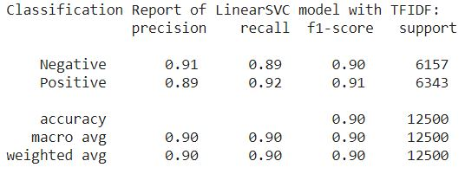
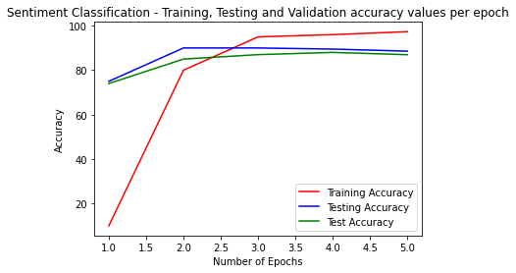
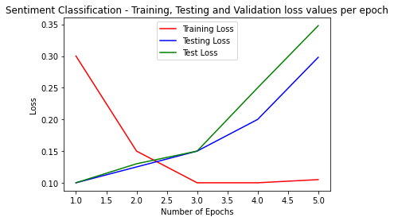
COMPARISON BETWEEN LINEARSVC AND CNN
Figure 4: Accuracy and evaluation metrics of LinearSVC model
Figure 3: Plots of accuracy and loss values of CNN model

Slide 9
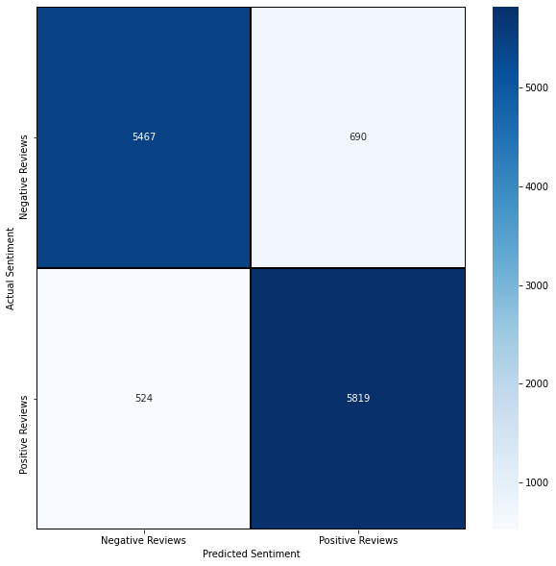
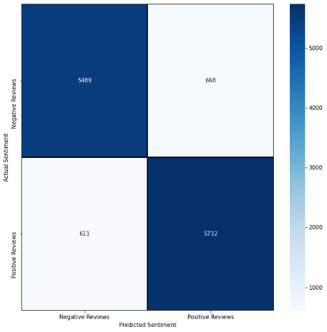
COMPARISON BETWEEN LINEARSVC AND CNN
Figure 5: Confusion Matrix of LinearSVC model with TF-IDF
Figure 6: Confusion Matrix of CNN model

Slide 10


